Slide 1
Al-Farabi Kazakh National University
Higher School of Medicine
Molecular and genetic basis of immunity.
Lecturer: PhD Pinsky Ilya Vladimirovich

Slide 2
LEARNING OUTCOMES
As a result of the lesson you will be able to:
1. Describe the main histocompatibility complex and its role in human immunity.
2. Explain what humoral and cellular immunity is.
3. Classify and characterize proteins involved in humoral and cellular immunity.
4. Describe congenital and acquired disorders of human immunity.

Slide 3
Literature:
1. Alberts et al, pp. 1297-1342.
2. Lodish et al, pp. 1079-1134.

Slide 5
Proteins and signal molecules involved in humoral and cellular immunity
Complement system
Cytokines and chemokines (interleukines, interferons, prostaglandins, tromboxanes, eicosanoids, leucotriens, tumour necrosis factors (TNFs) and etc.)
Cell-surface receptors (MHCI, MHCII, TCR, etc.)
Antibodies (immunoglobulins)

Slide 22
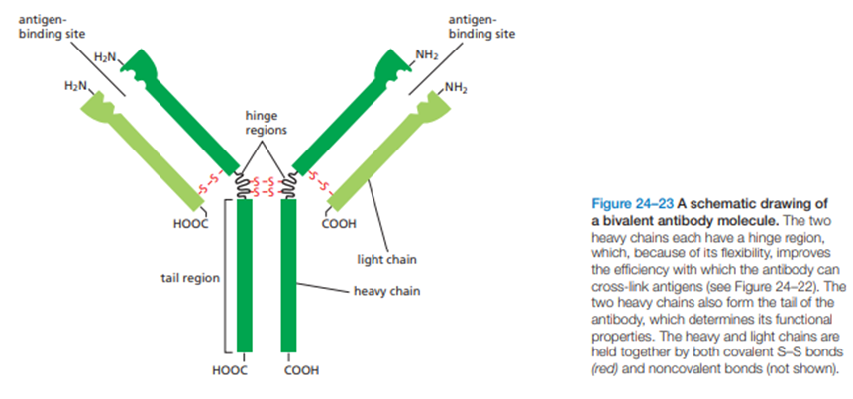

Slide 35
Disorders of human immunity
Immunodeficits (SCID, AIDS, etc.)
Autoimmune diseases
Allergic diseases

Slide 36
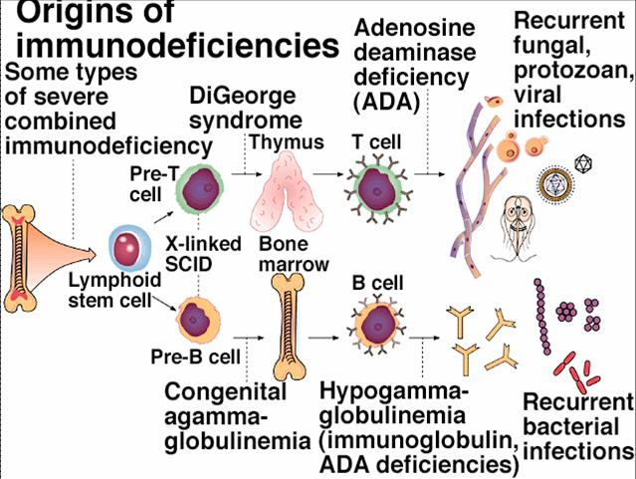
https://www.google.com/url?sa=i&url=https%3A%2F%2Funiverse-review.ca%2FR10-40-Immune.htm&psig=AOvVaw3Jieddj2VMZ97JDSzEme1R&ust=1638126096814000&source=images&cd=vfe&ved=0CAwQjhxqFwoTCNDClLSdufQCFQAAAAAdAAAAABAZ

